Slide 1
Post-Cutover to Interval Billing Deep Dive Workshop
02/06/2014

Slide 2
Agenda
Opening Remarks
Who's Here
Review Previous Workshop Outcomes
Review of VEE in MDM Requirements for Interval Reads
Process Drill Downs
Interval Billing Lifecycle VACD
VEE in MDM
Communication Problems
Analytics/ Business Reporting & Performance Expectations
Requirements Captured
Review Action Items
Participants Needed for Next Workshop
Wrap Up and Next Steps

Slide 3
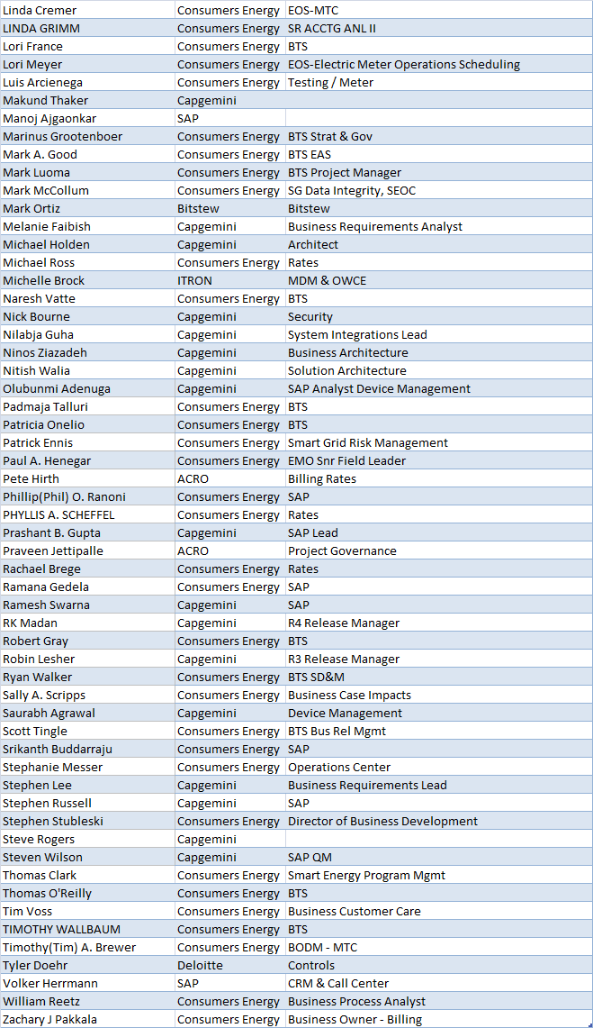
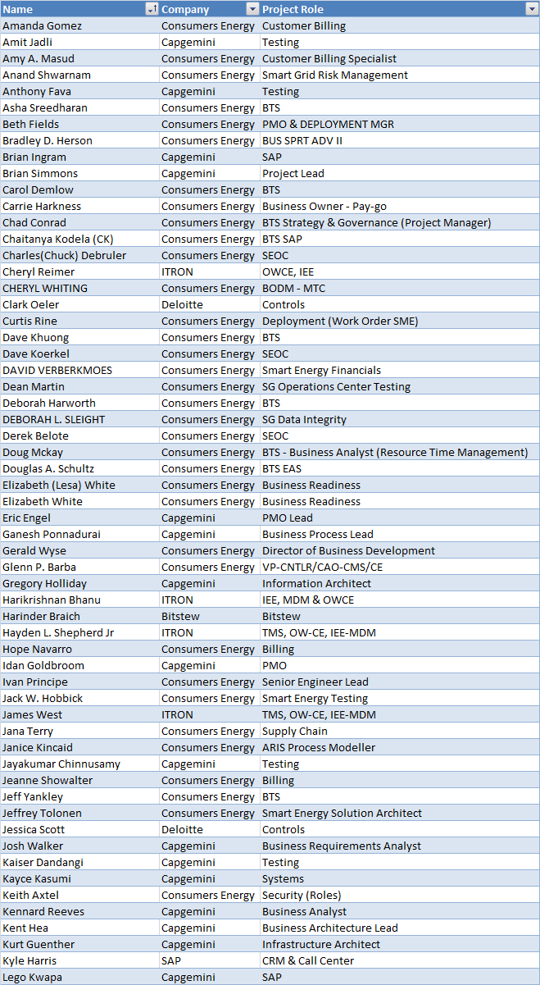
Deep Dive Attendees

Slide 4
High Level In-Scope Considerations
Interval Reads – Residential and C&I (Commercial & Industrial)
Consumption vs. Index
Max Demand (Interval)
Power Factor (Interval)
It was noted that all residential and commercial & industrial customers that have intervals stored in MDM have AMI meters
It was noted that only max demand and power factor will move to interval reads for billing
No residential customers will use interval billing in R4 (it is anticipated that interval consumption reads for Residential will be covered in R5 when Time Of Day rates will be introduced)
Any customer with AMI meters will have interval reads
Single Phase meters are on 60 minute intervals (with a select group on 15-minute intervals) – C&I only for R4
Polyphase meters are on 15 minute intervals
Read Rate Analysis
Special Non-Billing (i.e. Read-Only) meter reads are taken for Rate Analysis
Both max demand and power factor based reads are used for rate comparison and analysis
This analysis helps determine if customer need to move to a new rate category (e.g. GS to GSD)
ACTION: A focus group meeting will be arranged to look at the changes around this analysis involving interval reads now available
Direct Load Control - Residential and Small Business
Currently load control customers are on an index rate
Interval billing is available to customers who bill OTA and any customer that signs up for a program requiring interval billing
For the future, 15 minute intervals will be needed in R5
Meter Reading & VEE
This will be required for interval OTA billing
Gap Fill & Estimation
This will be required for interval OTA billing
This needs to be explored further with the MV90 customers
Customer Enrollment - C&I
Max demand
Power Factor
Opt-Out - Residential and C&I
Need to consider process for going back to manual reads and legacy meter for an existing AMI (interval) meter
Need to upload interval meter data before swap

Slide 5
High Level In-Scope Considerations
Billing Preparation & Presentment - Residential and C&I
Index reads and usage currently billed
Move to interval now involves recorded estimated/actual/total data
What constitutes estimated vs. actual interval?
How to present information on the bill and how to show the differences?
Non MV90 customers on AMI intervals – what to do with those customers?
Index is presented with line items showing total and estimated meter reads and graphic of historical usage
Do we still need to show index (like MV90)?
Do we need to show actual, estimated and total recorded consumption on the invoice (like we do with MV90 customers)?
Billing Determinants & Validations - Residential and C&I
Recorded usage vs. index
MDM uses index reads to compare against recorded intervals
Is gap-fill switched off in OWCE and MDM? Need to explore
Customer Billing Enquiry - Residential and C&I
Need to explore customer enquiry process for potential changes
AMI Meter Deployment (Cutover) – NOW BACK IN SCOPE
Transition from Index-based reads vs. new interval reads for read verification
Validating kWh registers (changes to CARS)
Cancel/Re-Bill (aka. Reverse/Re-Bill)
Residential and C&I – IN SCOPE
No Process Change

Slide 6
Out of Scope for This Workshop
Gas Metering & Estimation
Customer Enrollment & Outreach Channels for DLA & DPP
Electric or Gas Register Billing
Customer Selects Due Date (for Bill)
TOU – Residential and C&I
On/Off peak or High/Med/Low
Consumer Portal - Residential and C&I –
It was decided to have an offline conversation with Zach Pakkala to discuss further details
Index rate customers still get interval view on portal
PayGo Program
Data Recovery in the HE
Meter Reading Schedule
Theft Detection (impacting Billing)
Outage Management (impacting Billing)
Remote Turn-On/Offs (impacting Billing)
Net Metering (impacting Billing)
Needs 15 min interval reads
PEV (Plug-In Electric Vehicle)
ODR (On Demand Read) will always be index based
Customer Selection - Residential and C&I
Only for programs that require interval data
R4 will only focus on C&I customers
Customer Migration - Residential and C&I
Cutover for max demand/power factor from manual to interval OTA
Moving residential from index OTA to interval OTA based on program enrolled
AMI Meter Deployment (Cutover/Route Closure/HQ Turnover)
R4 will only focus on C&I customers

Slide 7
Scope Assumptions for Post-Cutover to IB– R4
Effected Population & Rate Considerations
Small commercial customers are GS and GSD and customer choice rates
Large commercial customers are GP, GPD and customer choice rates (generally billed off MV90 metering)
Are there any other rates to consider?
Response: Rate analysis for customers who request rate comparisons
There are 9,000 single phase meters (residential) single phase billed on a demand tariff; Do we plan on having the 9,000 meters pre-programmed for Interval OTA?
Complex billing determination is more complicated for Commercial & Iindustrial (C&I) customers
What are we targeting for these C&I customers - i.e. MV90 or SAP EDM + real-time pricing? This may translate to an increase in degree of difficulty!!!
ACTION: This is a question for the BP Policy Meeting.
Eliminating MV90 to replace with IEE-MDM may not happen, but objective is to minimize MV90 ; Anticipate low volume for “gas” functions, high revenue customers and security issues will keep MV90 from being completely eliminated
Changes to functional groups require a meter swap (OTA config group/function -- Meter program)
Changes are required to the technical master data within both SAP and IEE support the interval billing process, namely the creation (ties to install/remove/replace processes), allocation to the register, and replication of interval “profiles”
How do we handle the change of rate meter configurations?
What is the rate assignment process for move-in/move-out situations?

Slide 8
Scope Assumptions for Post-Cutover to IB– R4
Interval Data Needs
Business Rule: Interval Data will be stored in the MDM for 84 months
Discussion on timeframe of how long to store data in the MDM
How often do you need access to the data? Is it for Archive or immediate access?
Response: 3-year billing for real-time access
NOTE: 3 years is not to be acknowledged as the corporate storage policy
60-Minute intervals for Residentials; 60 or 15 -minute for Commercial & Industrials not billing on demand
Single Phase meters used for some C & I customers will use a 15 minute interval
9K customers use GSD
60 minute intervals CANNOT be used for Demand Billing
Can we use 60-min for rate analysis?
Response: Currently rate analysis is performed monthly, therefore 60 minutes will be sufficient
Is this in Grid Director, SAP or ACT?
15 minute intervals for Commercial & Industrials required for demand based rate categories (i.e. max demand or power factor billing)
Are we officially going to send demand and kVARh reads for ALL C&I accounts?
Needs to be clarified based on further rates analysis
Business Rule: Nothing less than 15-minute intervals for any customer, unless special category created
Business Rule: There are limitations of up to 7 meter registers in the Openway HE
NOTE: Not all registers are needed

Slide 9
Scope Assumptions for Post-Cutover to IB– R4
Validation & Verification
Does MDM know the difference between missing read and a corrupt read?
Interval limitation in MDMS implies 4 validations types for single phase and 20 for polyphase ( GE) ???
ITRON recommends using a limited number of validations for R4 based on the number of resources currently available within MDM; hence few validation checks were selected
Discussed that the existing models must comply with the current MV90 Calculations – Compliance (MPSC)
High/Low MAY be done – but decision is not yet final!
Is there a conflict that may exist with the validation rules within SAP and those of MDM?
Best way to handle this is not to turn on power outage – Would like to make sure we can utilize outage notification for ALL meters that can talk to us
Response: IEE puts a status on the intervals
Gap-fill interrogation (an extension of VEE), will need to be turned on for interval billing
What does Consumers do with meters that have stopped communicating?
Response: There needs to be a backup plan for collecting intervals (Field Tools?)

Slide 10
Scope Assumptions for Post-Cutover to IB– R4
Billing Determinants & Rate Considerations
Appropriate SAP and IEE rate configuration changes may be needed, development of formulas are required to allow for interval billing determinant requests
The existing deployed meters have register channels that are pre-programmed according to the current TOU time periods and thereby Consumers Energy has some flexibility with respect to how many TOU rate categories are migrated over to using interval data as part of the billing calculations (NOTE: TOU is in R5)
Complex billing determination is performed in MDMS with distinct determinants back to SAP billing system (for interval billing) Why is this only for residential customers?

Slide 11
Out of Scope Assumptions for Post-Cutover
Time of use is supported through on/off registers
Clarified Time of Use is for C & I customers
Clarified Time of Day is for residential customers
R5 Multiple TOUs scheduled, based on the rate (On-peak, mid-peak, off-peak) will be through different registers
Gas communications module won’t be deployed until Q3 2014 and this is with Centron via Openway and assuming not through TMS
Customer Selection Considerations
Rate Codes
TOD – Time of Day is for R5
TOU – Time of Use (Total Monthly Category) is for R4
Interval Demand Eligibility Rules
Customer has a value added need for it
Meter type available
Interval Consumption Only Eligibility Rules
Customer has a value added need for it
Meter type available
Customer Segmentation
Customer Acquisition Process
Outreach
Qualification
Conversion/Migration
Retention
Customer Migration Considerations
Cutover Targets
Less important than validation and strong communication targets
Enrollment Wave Calendar
Not sure this has been defined yet
Enrolled Meter Counts by Headquarter/MRU
Validation met – 1 month or 2 months?

Slide 12
VACD Model/Process Models

Slide 13
Requirements

Slide 14
Action Items
What | Due Date | Status | Owner | Comments
Discuss difference between the MDM’s ability to pull the current month maximum demand vs. the need for an on-peak demand (GSD rate categories all utilize the current month maximum demand (need to verify case of the 60% clause) |  | Closed |  | No on peak demand needed
Need to have a detailed architectural discussion around what “complex” billing determinants will be calculated by the MDM. We have invested over 15,000 hours (rough estimate) in the complex EDM billing configurations in SAP. There are significant doubts that the MDM can replicate these determinants. Need to also review direction of adding such significant replication of effort when we have other options. |  | Defer | SE Core Team | Moved to BP Policy Meeting Discussion
What happens in the case where the MDM doesn’t have anchor reads, and there are missing intervals? How is the ending index going to be generated? | 2/7/2014 | Open | Pete Hirth, Cheryl Reimer, Tim Wallbaum | MDM will estimate the missing interval. How will the 3-day window work with interval billing?
Need to discuss the need for EDM profiles for true interval billing. This is not necessary for R4, but it is my understanding that it is a requirement for R5? | 2/7/2014 | Open | Zach Pakkala | Related to MV90 → SAP/MDM configuration IEE needs rates table for this change
Should Grid Director be considered for Rate Analysis? | 2/7/2014 | Open | Dave Koerkel | What data needs to be stored in both single phase and polyphase?
Performance tests: Test the OTA meter progress change: 60 min to 15 min. | 2/7/2014 | Open | Jack Hobbick | Collecting requirements for performance tests New Installer/Rate Change

